Slide 1
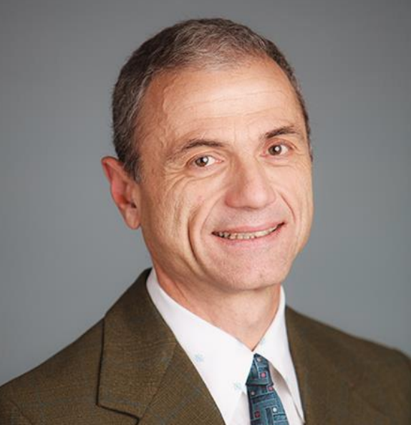
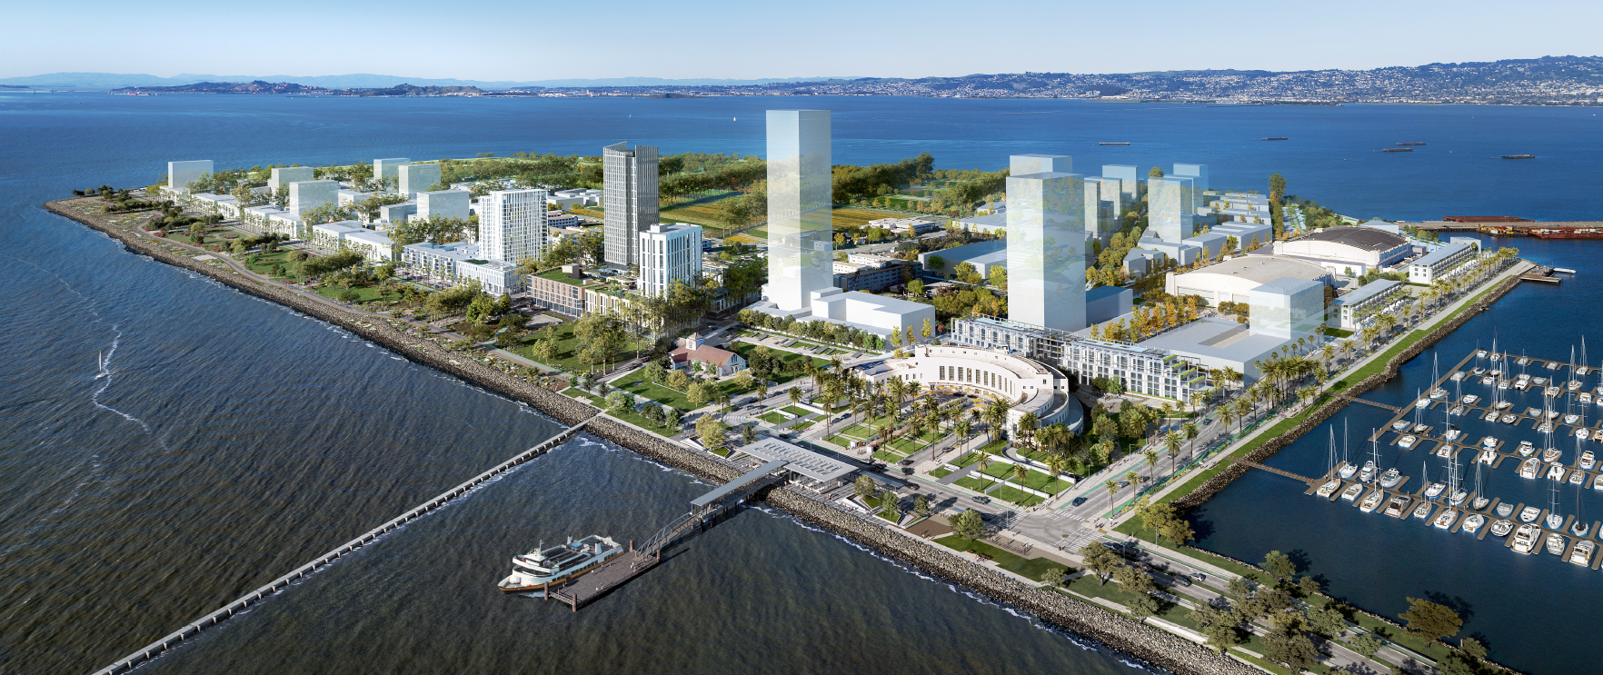
TREASURE ISLAND
Built on History, Engineered for the Future
March 21, 2024
2024 Golden Gate Branch Monthly Activity
DEVELOPMENT PROJECT OVERVIEW
SPEAKER
In 2011, the SF Board of Supervisors unanimously approved an $8 billion development plan to create a complete new neighborhood at Treasure Island, with stunning views spanning from the Bay Bridge to the Golden Gate, that responded proactively to the most important challenges of our time. Streets and buildings are designed to optimally maximize the effects of sun and minimize the impacts of wind. The project plan includes measurable strategies and best practices to achieve sustainable site development, water savings, energy efficiency, sea-level rise adaptation, and overall environmental quality. During planning, the project adopted a geotechnical stabilization strategy that focused on protecting the overall integrity of the island by creating a seismically resilient, stable platform and perimeter shoreline for this development. The development plan is based on the principles of equity and inclusion. Of the 8,000 planned new homes 27% includes low-income units, retail space, office and commercial space, hotel rooms, adaptive reuse of three historic buildings, a new transportation hub with a new ferry pier, a new marina, and approximately 300 acres of public parks and open space. It includes raising the developed land above the 70-year sea-level rise expected flood level & developing an adaptive management plan for long-term sea-level rise.
STEFANOS A. PAPADOPULOS, GE
Stefanos is a licensed Geotechnical Engineer in California and a Principal at ENGEO.
REGISTRATION
Thursday, March 21, 2024
Networking: 5:30 - 6:30 PM
Dinner 6:30 - 7:10 PM
Program 7:10 - 8:00 PM PDT
Scott's Seafood Jack London Sq, Oakland, CA 94607
2 Broadway, Franklin Street Entrance
Oakland, CA 94607
https://www.linkedin.com/in/goldengatebranch/

